Slide 1

Get Smart: With Java Programming
Yaman Omar Alashqar
System.out.println(“WELCOME TO THIS COURSE\n”);

Slide 2


Slide 3

One question Jeff Bezos is often asked
is one we all need to ask ourselves,
“What’s going to change in the next 10 years?”

Slide 4
It’s a profound question because the world is changing so rapidly, and because the decisions we make now will determine our destiny.
Decide wrong, and you might find yourself on a sinking ship, watching as your whole industry goes bankrupt and the skills you spent years honing become obsolete.
Decide right, and you could be set for life. The top artificial intelligence programmers, for example, make as much as NFL superstars.

Slide 5

“What’s Going to Change?”
Is The Wrong Question
Lets Reframe it
“What’s NOT going to change in the next 10 years?”

Slide 6

“You can’t predict, you can prepare.”
— Howard Marks

Slide 7

“You can’t predict, you can prepare.”
— Howard Marks
“Predicting rain doesn’t count. Building arks does.”
— Warren Buffett

Slide 8
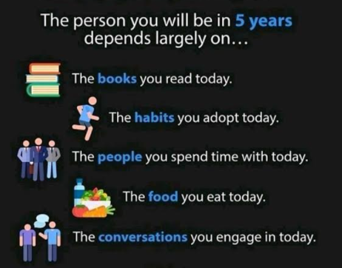
Notes:
news you're exposed to
accounts you follow

Slide 9
Bezos talks about how focusing on stable customer preferences is a powerful foundation to build a company around.
I’d take that a step further: focusing on stable knowledge is a powerful approach to build a life around

Slide 10

Agenda (Next 15 Minutes)
The IT Industry
College Degree vs Courses
Career Path
Self Introduction (Part 1)

Slide 11

The IT Industry
Programming is, quite literally, all around us.
From the take-out we order, to the movies we stream.
Code enables everyday actions in our lives.
Tech companies are no longer recognizable as just software companies
instead, they bring food to our door, help us get a taxi, influence outcomes in presidential elections, or act as a personal trainer.

Slide 12
The IT Industry
As programming becomes a larger part of our lives, it’s vital that everyone has an understanding of what programming is and how it can be used.
Programming is important to our careers, but it also plays a key role in how we participate in politics, how we buy things, and how we stay in touch with one another.
Learning to code is an exciting journey.
Whether your goal is to build a mobile app, search a database, or program a robot, coding is a skill that will take you far in life

Slide 13


Computers can enhance all professions
As technology continues to advance, every machine will need a program that will operate the hardware to function
FORBES: Is AI Going To Be A Jobs Killer? New Reports About The Future Of Work
FORBES: The Alleged Threat Of AI Taking Away Human Jobs Is Not What We Think It Is
BUILTIN: AI AND ITS IMPACT ON THE FUTURE OF JOBS
“ Artificial intelligence is poised to eliminate millions of current jobs and create millions of new ones —
some of which haven't been invented yet.”

Slide 14

The IT Industry
#computer_science
#software_engineering
#AI
#data_science
#cyber_security
#CIS

Slide 15

Computer Science
Emphasizes the theoretical side of computer software and hardware.
Develop effective, reliable software.
The broad nature of computer science allows learners to choose from many specializations and career paths, including those related to mobile computing, artificial intelligence, data analytics, and cloud computing.

Slide 16
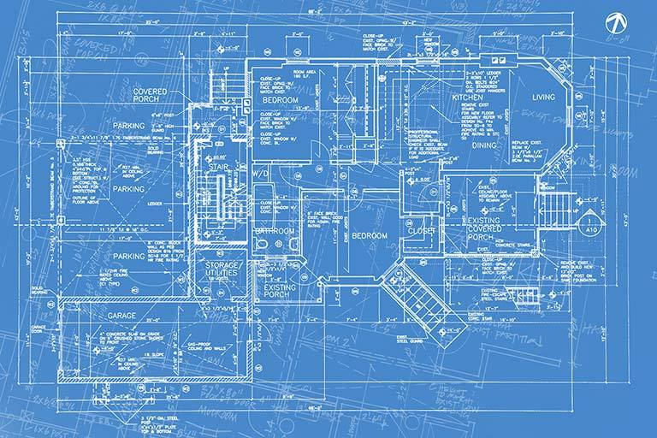
Software engineering
Applies the standards and principles of engineering to design, develop, maintain, test and evaluate computer software.
Software engineers may also be the programmers who test and perform quality assurance checks on new and developing software to ensure its efficacy and efficiency in its real-world application

Slide 17

Computer Information Systems
They use their programming and design expertise to integrate and maintain technologies, while employing project and administration management skills as they oversee each component of a project.
They primarily focus on how technologies operate within a business environment, choosing the most effective option based on their organization's needs.

Slide 18

Data Science
Combines theory and practice, based on three main disciplines, Computer Science, Statistics and Mathematics, and real world application domains.
Acquiring, managing, analyzing and extracting insight from data

Slide 19

Artificial Intelligence
Develop AI applications, such as speech recognition, facial recognition, and computer vision.
Areas of study may include data mining, advanced mathematics, engineering, and robotics

Slide 20
College Degree vs Courses
Filling The Gaps
Connecting The Dots
Intellectual maturity
Depth required for stability/development
Time Commitment
Curriculum
Certificate
Job Opportunities
Notes:
" العلم يبني بيوتاً لا عماد لها، والجهل يهدم بيوت العز والكرم "

Slide 21
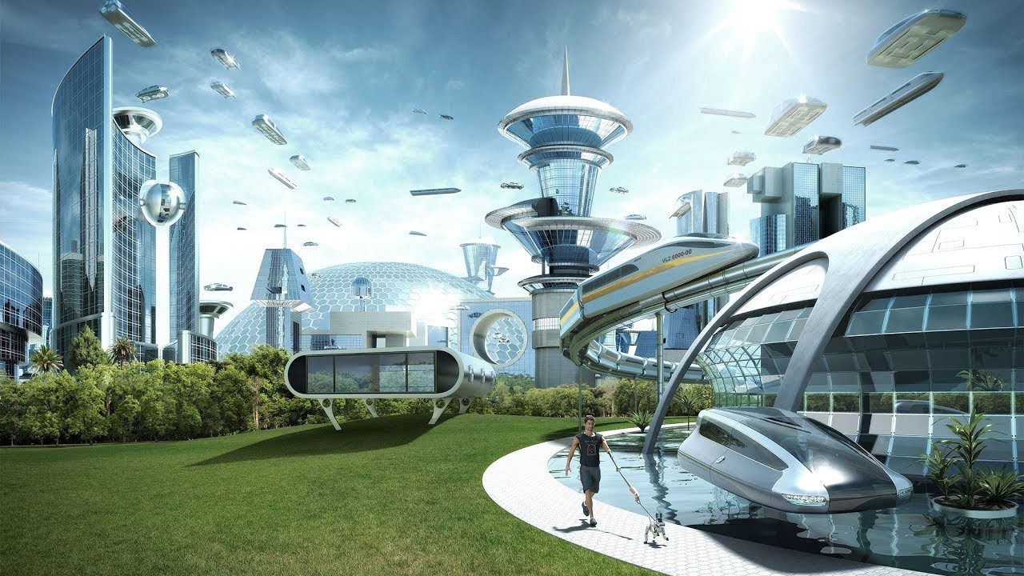
When choosing a new career path here are some good must-haves and nice to-haves:
It must be relevant for the next 10+ years.
This skill should be valued many years in the future guaranteeing your job security.

Slide 22
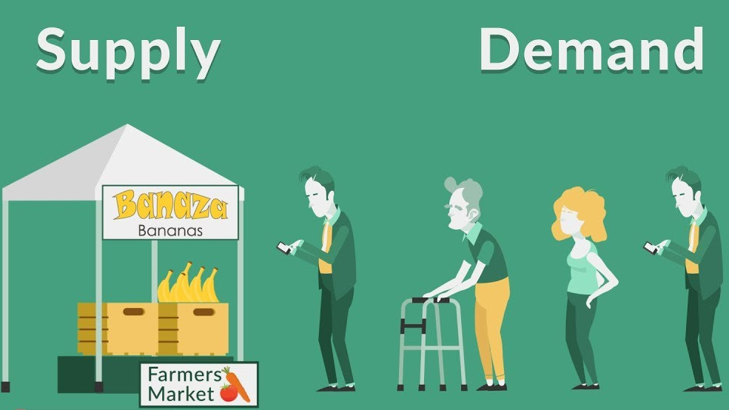
When choosing a new career path here are some good must-haves and nice to-haves:
2. Demand for people with this skill must be higher than the supply.

Slide 23
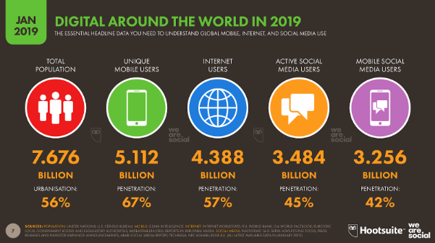

Slide 24

When choosing a new career path here are some good must-haves and nice to-haves:
3. High salary regardless of your number of years in the industry.
You don’t want to spend many years climbing the corporate ladder until you make a decent living.

Slide 25

FACT
Software Developers earn an average salary of $108,080 PER YEAR
Average freelance developer salary is $2,538 PER WEEK

Slide 26
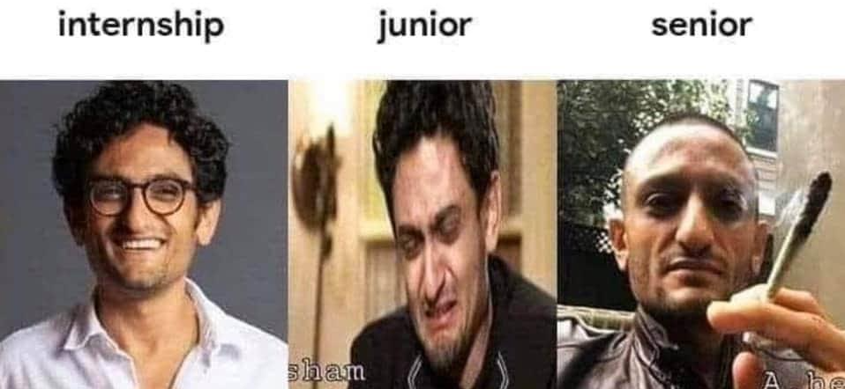
When choosing a new career path here are some good must-haves and nice to-haves:
4. Ability to catch up to the top performers in the industry in the shortest amount of time.
Can little experience still get you employed?
And can you close the gap as fast as possible to be considered a senior or an expert in the field?
Notes:
Because seniors will need juniors to implement some code …
They need fresh minds to learn new things quickly …
Seniors could design, analyze, architect …

Slide 27
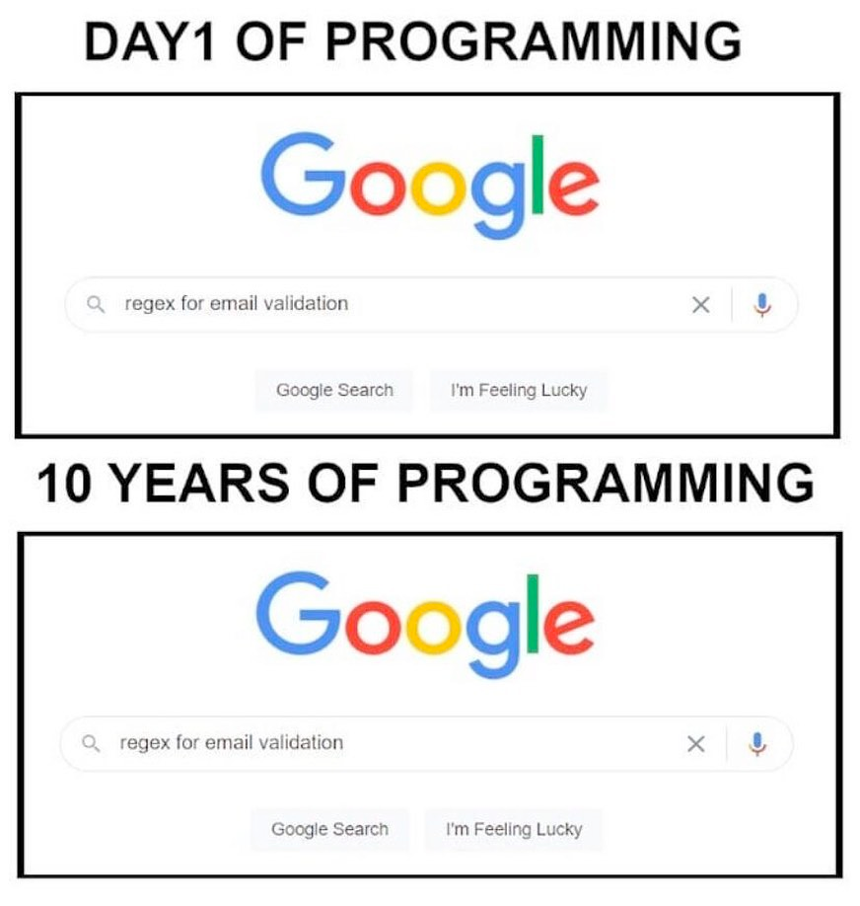

Slide 28

When choosing a new career path here are some good must-haves and nice to-haves:
5. Have fun. This is the most important one.
Can you see yourself doing this 40 hours a week for a long time?

Slide 29
Self Introduction
Notes:
I studied other people’s experiences, looked at job postings, spoke to established developers, reviewed online courses, and read articles. Based on those, I created a curriculum for myself focused on efficiency

Slide 30
Agenda (Next 15 Minutes)
What is this course all about?
Approach
Learn Java? Kotlin? Python?

Slide 31

IT’S TIME TO DIGITIZE YOUR IDEAS

Slide 32
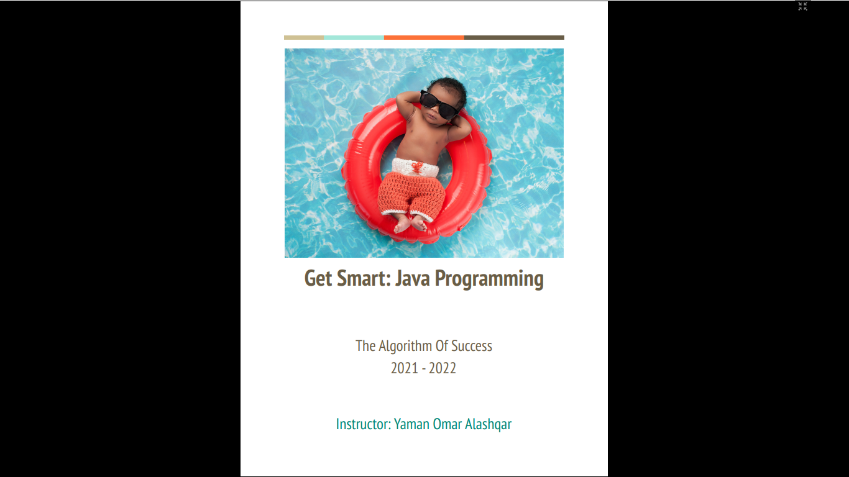
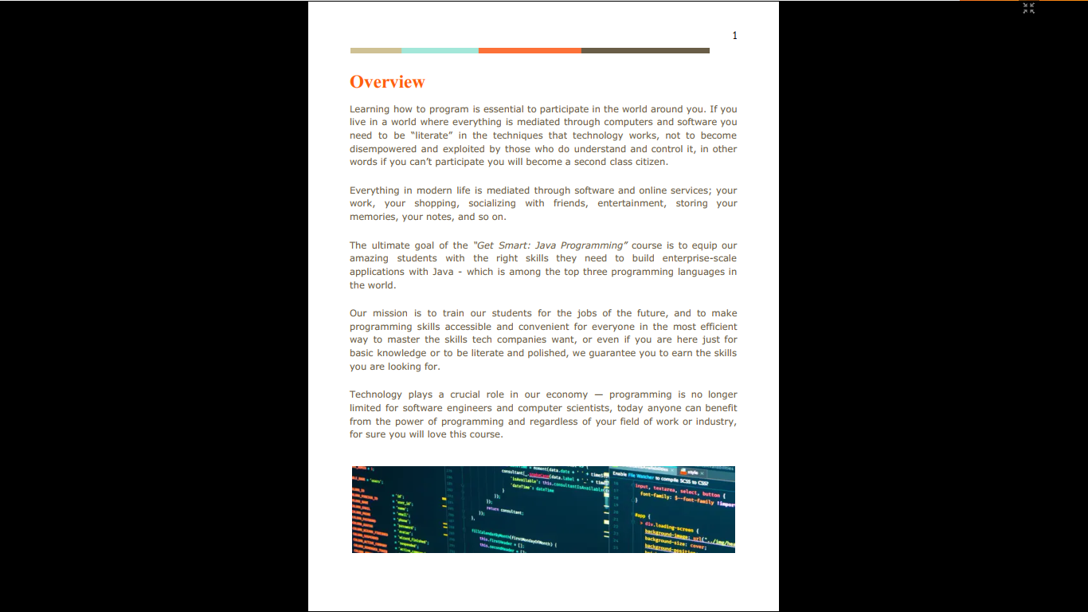
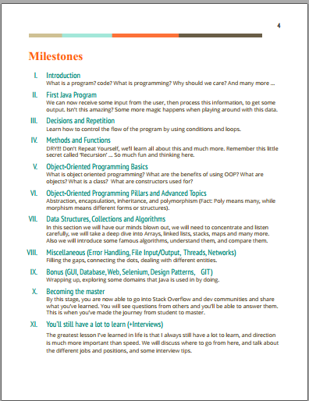
COURSE OUTLINE
Notes:
OPEN IT AT THE END

Slide 33
COURSE OUTLINE
Program/Software/Application
What is a program?
Program vs software/application
Why do you need to know how to program?
Programming languages
What is a programming language?
Human Language vs Programming language
What is Java? Why Java?

Slide 34
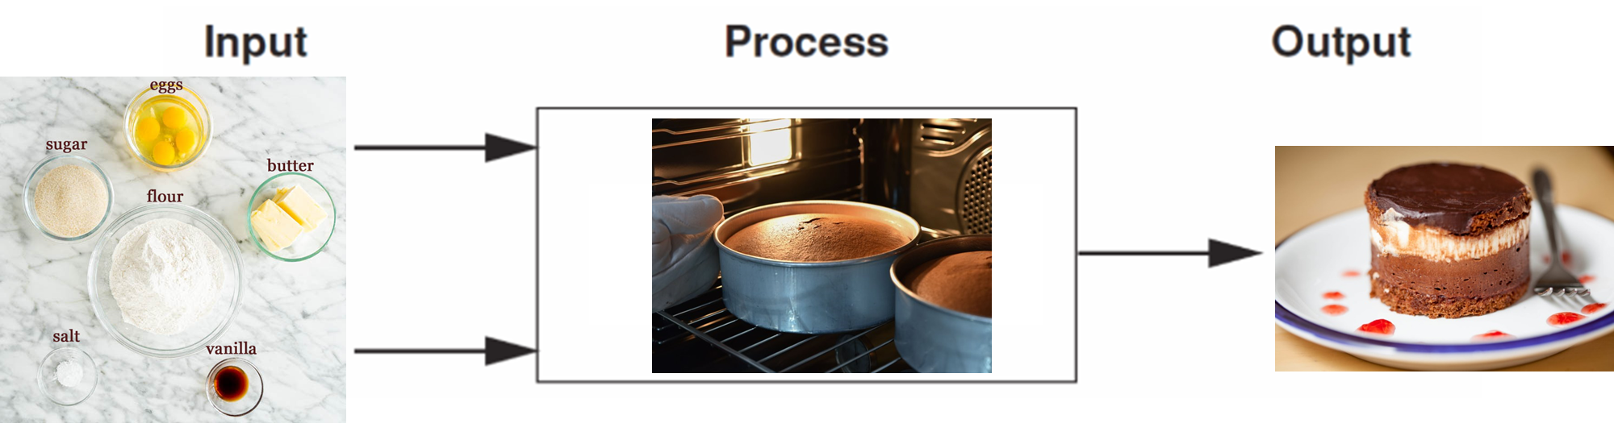
COURSE OUTLINE
Basics of programming
Input -> Process -> Output
Memory Concepts
Decisions and Repetition

Slide 35

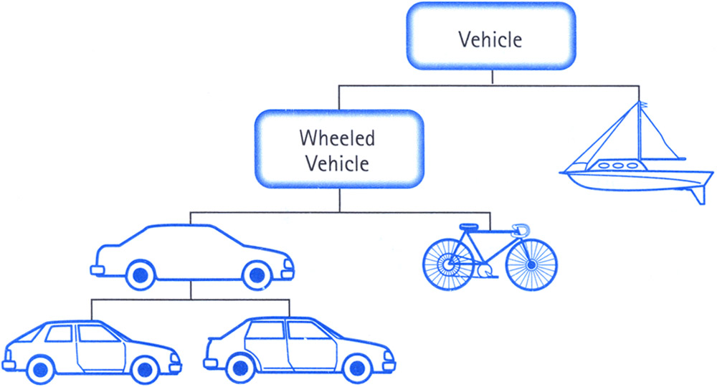
COURSE OUTLINE
OOP (Part 1)
Objects / Class / Constructor
Methods
Notes:
An “object” is anything that has some data and functionality associated with it.

Slide 36
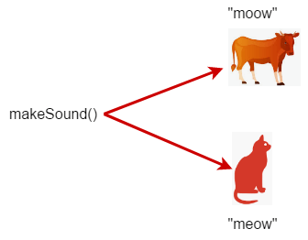
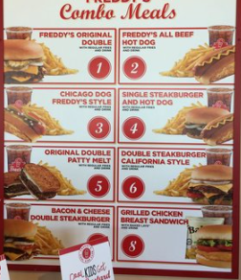
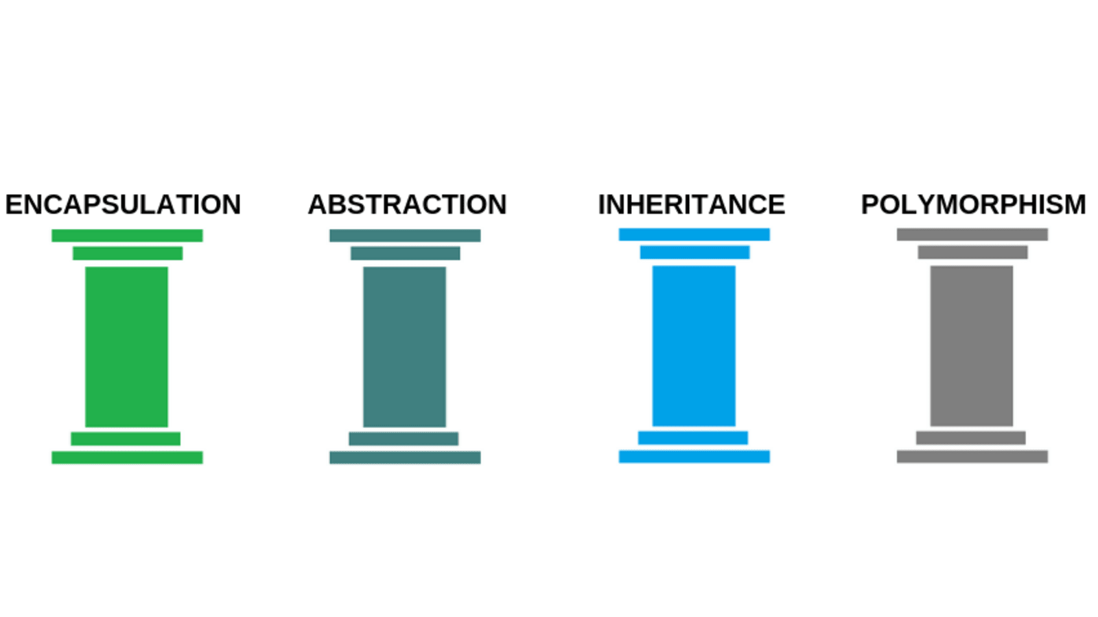
COURSE OUTLINE
OOP (Part 2)
Four Pillars
Notes:
Restaurant Abstraction example … Combo 3 -> Leads to so many steps

Slide 37
COURSE OUTLINE
Encapsulation is a process of wrapping code and data together into a single unit.
Just like a capsule which is mixed of several medicines.
Notes:
Read-Only class
Write-Only class

Slide 38
COURSE OUTLINE
Without Abstraction
"Boil the water“ button
"Add the cold water to the kettle“ button
"Add 1 spoon of ground coffee to a clean cup“ button
"Clean any dirty cups“ button
With Abstraction
A "Make coffee“ button
Showing only the essential features of an object to the user and hiding the inner details.
Notes:
Second approach abstracts away the logic into the machine. But the first approach forces the user to understand how to make coffee and essentially make their own.
int min = Math.min(5,6); double power = Math.pow(2,3);
UBER/CAREEM -> FROM LOCATION + TO LOCATION (SAME FUNCTIONS)

Slide 39
COURSE OUTLINE
Inheritance lets one object acquire the properties and methods of another object
Reusability is the main benefit here.
We know sometimes that multiple places need to do the same thing, and they need to do everything the same except for one small part.
Notes:
Whatsapp msg -> Photo / Text / Voice / Stickers

Slide 40
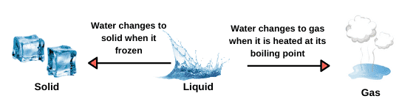
COURSE OUTLINE
Polymorphism means "the condition of occurring in several different forms."
Notes:
.render (different components)
.sound
Whatsapp msg -> Photo / Text / Voice / Stickers

Slide 41
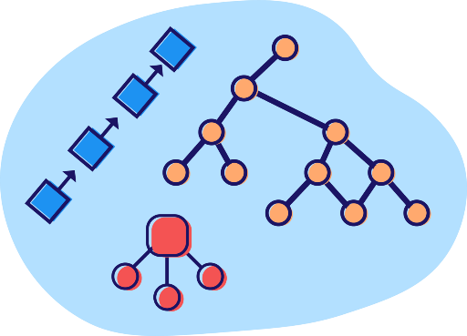
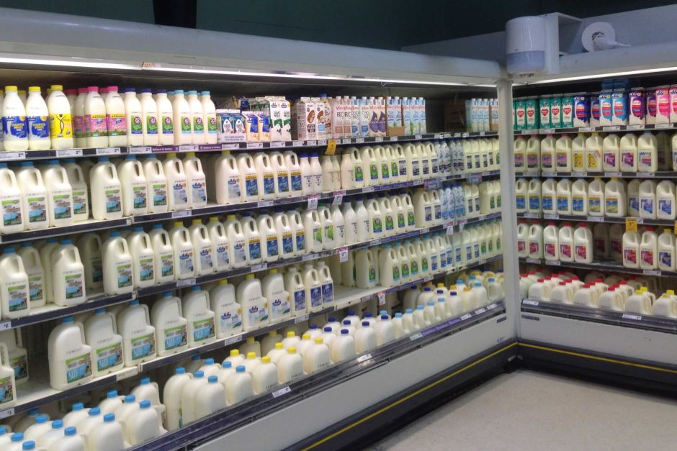
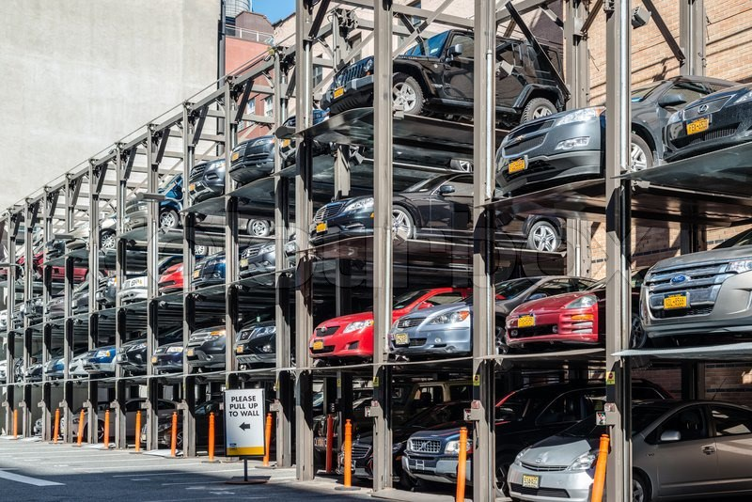
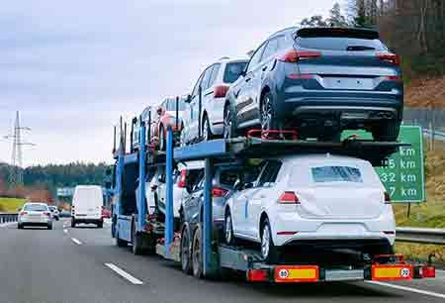
COURSE OUTLINE
Data Structures
Notes:
Why do we store the milk in the fridge, books on the shelf,
when we go out on a picnic we use a different container

Slide 42
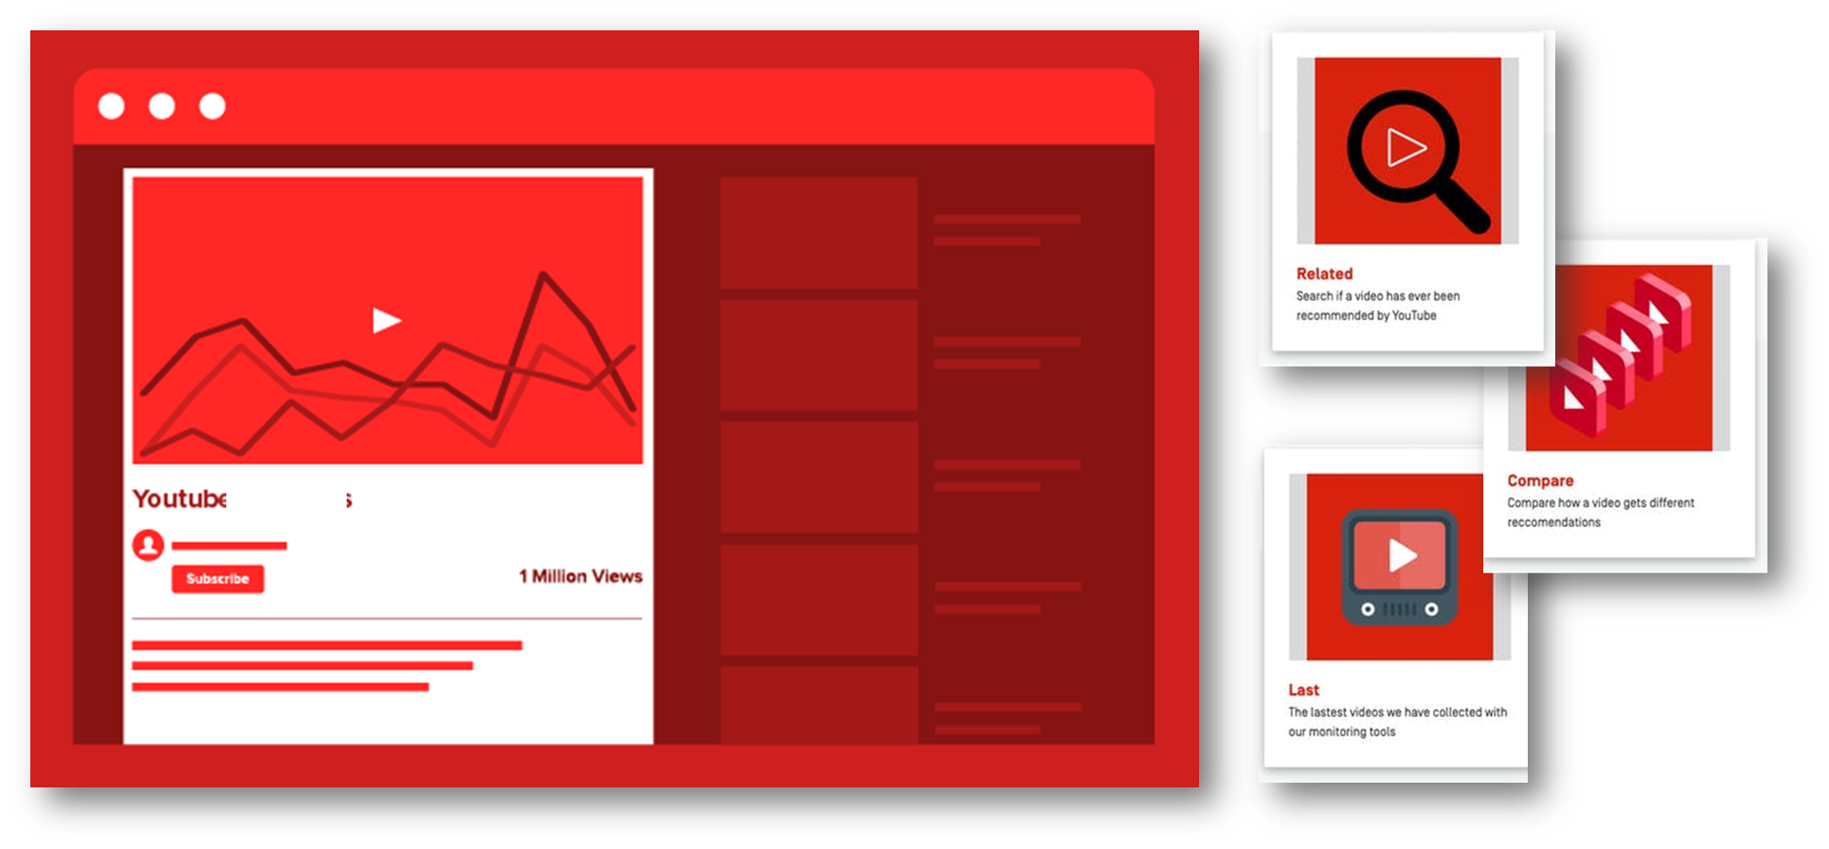
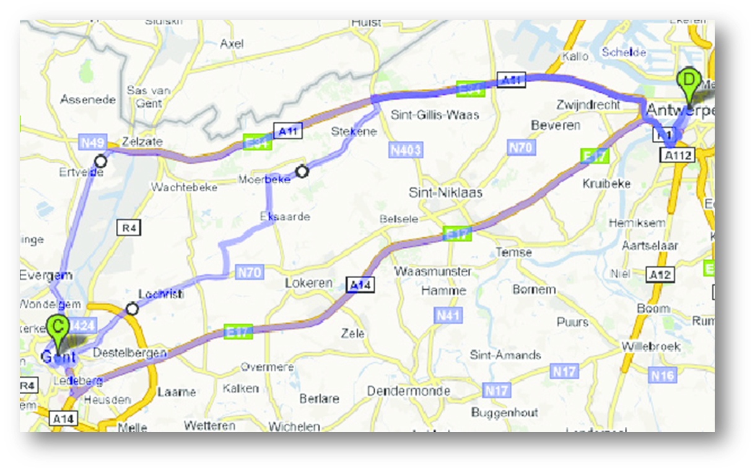


COURSE OUTLINE
Algorithms
Sorting
Searching
Famous Problems
Notes:
Algorithms, How does Facebook send you relevant ads, YouTube suggestions, Google maps shortest path

Slide 43
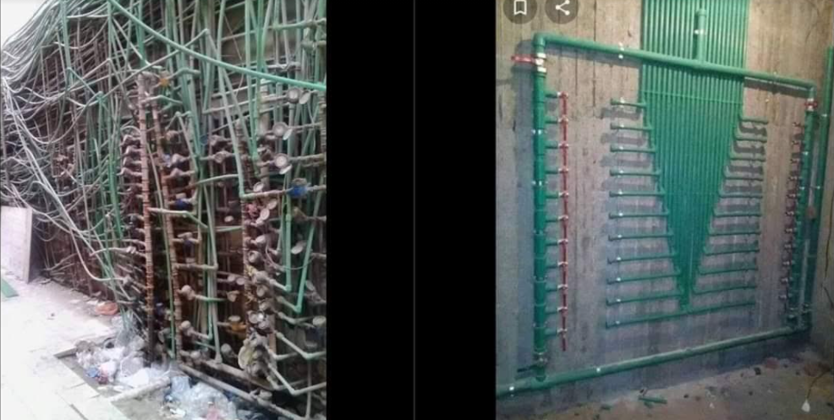
COURSE OUTLINE
Design Patterns
Notes:
Design Patterns, , reusable solution to a commonly occurring problem, It is a description or template for how to solve a problem

Slide 44
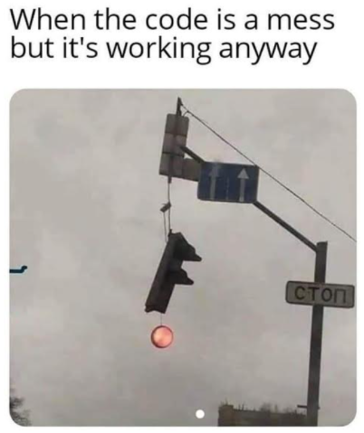
COURSE OUTLINE
Clean Code
Notes:
Clean code, just like a building, when it grows if the base is not strong it could break down.

Slide 45


How Will We Learn?
Notes:
The tiger’s story in Ghamadan … you will never forget this moment.
Neurons fire, Emotions crank up, that’s how your brain knows it’s something important don’t forget it.
Sitting on the sofa, warm blanket, and reading a Facebook post about how Kunafeh is made. (Your brain is making a favor by not storing all this info)
Your brain is trying to do a big favor to make sure that any non important content will not clutter up scarce resources.

Slide 46
How Will We Learn?
The trick is to get your brain to see the material you are learning as really important, crucial to your well-being.
Maybe as important as a tiger.

Slide 47
How do you get your brain to treat Java like it was a hungry tiger?
Slow Way:
Repetition
With enough repetition your brain says:
“You keep looking at this over and over, this must be important to you”
Fast Way:
Increase brain activity …
Putting words with pictures which makes your brain think how they could relate, and this causes more neurons to fire.
We used the power of repetition (but not the boring way) instead we repeat the same concepts in different ways and sometimes multiple scenarios or examples.
Using Metaphors
Exercises and Labs
Your brain will remember the tasks you do more than the information you read

Slide 48
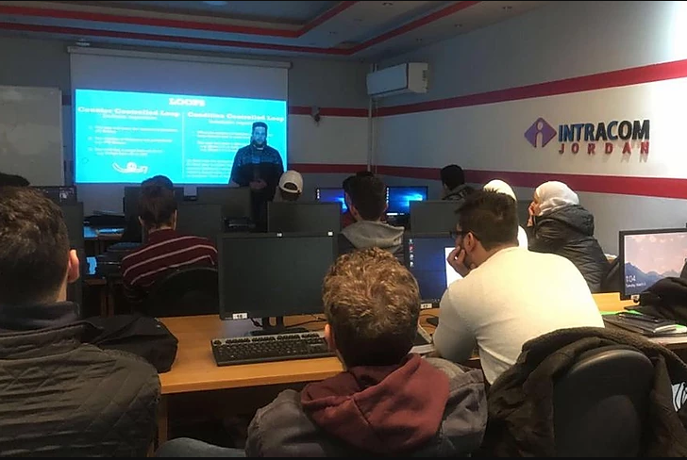
Our Classroom Experience
we’ve crafted our entire learning path to be the most effective way to learn employable job skills in the careers of the future.
Learn by doing
Job-focused content
Project-based
Active learning
Real-life Tasks
In Class Labs
Online Labs
Quizzes

Slide 49

Our mission is to train the workforce in the jobs of the future and to make learning in-demand skills accessible and convenient for everyone in the most efficient way to master the skills tech companies want.

Slide 50
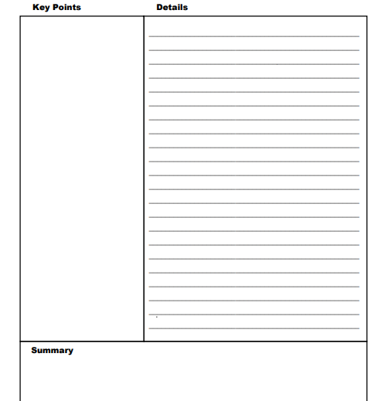
Cornell Notes
Take notes in the largest section of the page.
While listening to a lecture, take notes in the right-hand section of the page.
Include any information that is important in the slideshow.
listen out for points that are emphasized or repeated, as these are likely important.
2. Key points & Questions
After the lecture summarize the key points.
Write potential questions
Short keywords of the main ideas
3. Summarize the main ideas
Just do it in your own words, imagine you are explaining it to somebody else

Slide 51
Agenda (Next 15 Minutes)
Learn Java? Kotlin? Python?

Slide 52
Why do you need to know how to program?
in order to be able to tell a computer what you want it to do.

Slide 53
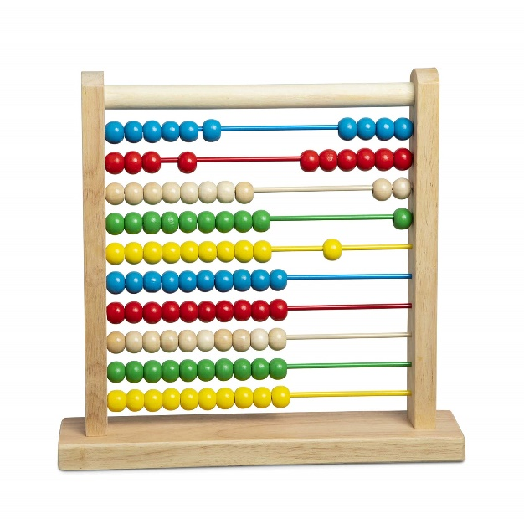
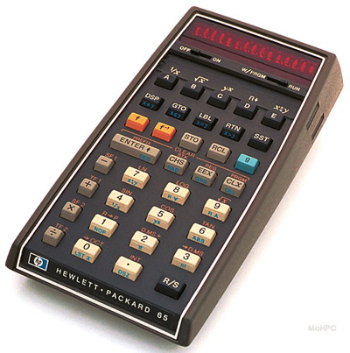
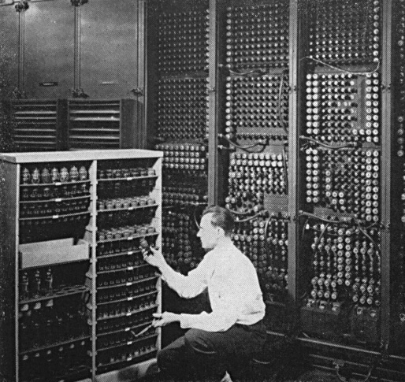
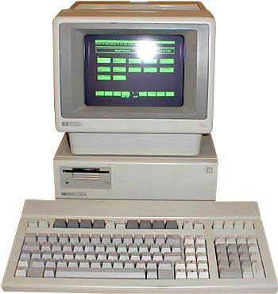

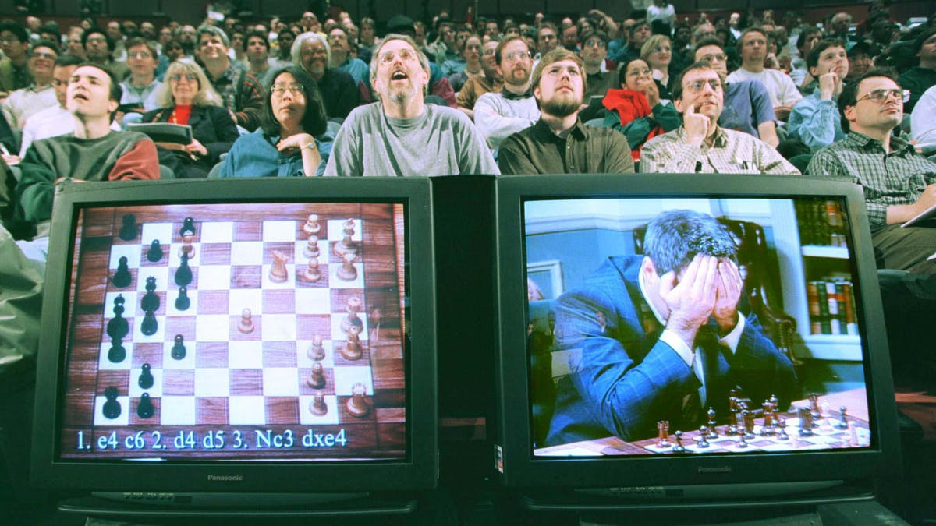


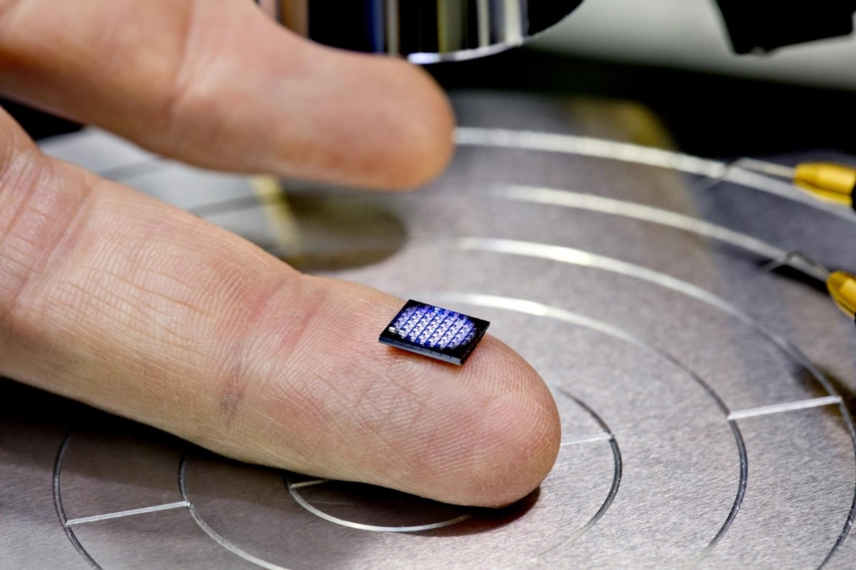


Notes:
8 + 5 = 13 ... Using a calculator back then was amazing
Then it improved and solved complex equations,
then it stored some data.
Then it manipulated this data.
Then the Internet came, communication begun.
Large amount of data was generated.
Almost 90% of data in the worlds history was generated in the past 100 years.
Lately some concepts such as DS and ML,
computers can now learn, predict, gain experience and much more.
In 1997 the computer won a chess game with the world champion
SELF DRIVING CARS.
Today we have Google Now and Siri...
WHO IS A ANDROID FAN.
NOW AFTER ALL THIS... BACK TO THE CALCULTOR EXAMPLE
8 + 5 = 13
WE WILL LEARN FROM THE STARTING BLOCK ... NO SHORTCUTS .. NO CHEATING
WE WILL LEARN THE BASICS, THE SYNTAX, HOW TO THINK LIKE A COMPUTER

Slide 54
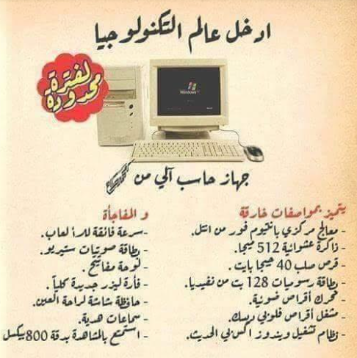

Slide 55
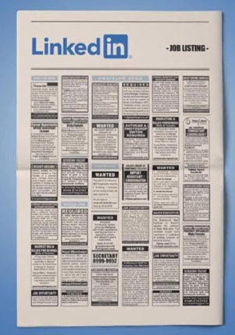



Slide 56




Slide 57
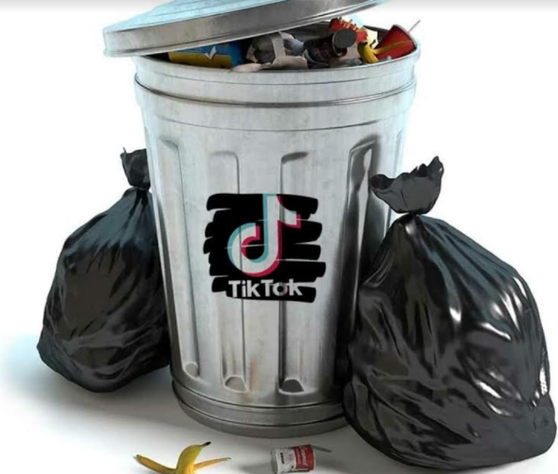

Slide 58
Why you would want to go down this path?
A. You want to be working in an industry where there is a high demand for the skill and many possibilities to be in important roles at the top of the food chain.
B. Location independent. You want a skill that allows you to go anywhere in the world and still be able to find a job easily. If you decide to move to Iceland tomorrow, you want to make sure that you won’t have issues finding a job.
C. You’ve noticed the difference between 2010 and 2021 and how much technological progress we have made in those short 10 years. You want to be at the forefront of an industry that is impacting the world.

Slide 59
Why you would want to go down this path?
D. We interact with technology on the daily, and you want to not be left behind in the dust as these take over our future. You want to understand and be able to pick up the skills underlying all of these technologies: programming is a great foot in the door to these industries.

Slide 60

Which programming language should I start learning first?
A programming language is simply a tool.
It is no different from any other tool in your hardware box.
If you want to hammer a nail, you should be using a hammer.
If you want to fix your water pipes, you’ll probably need a spanner.
Yes, it’s possible to hammer in a nail using the side of the spanner and the same programming language can be used to solve different types of problems.

Slide 61
Which programming language should I start learning first?
The carpenter will tell you that his favorite tool is a hammer and the plumber will say it’s the spanner, but it still doesn’t make it the “best tool to fix things”.
A frontend web developer will tell you that JavaScript is the best language to learn for a beginner. A statistician will advise you that you’ll be best served with the R programming language. But at the end of the day, all that matters is what you are trying to do with your tool.
But the good news is the core programming concepts: loops, conditionals, functions, etc. they’re all the same. The difference is mostly syntactical.
In English, we have werewolves, in German they have Werwölfe. It’s still the same.
So, decide on the task that you are trying to accomplish, then pick the best tool for that task.

Slide 62

The skill that most employers look for when recruiting is
the ability to think.
Knowledge is valued in a world where information is hard to come by.
In the 1800s, only the rich had access to good books and good teachers.
Now, everyone has all the information they had and more at the tap of a mouse.
Information is losing value, the ability to think is the stock to buy.

Slide 63
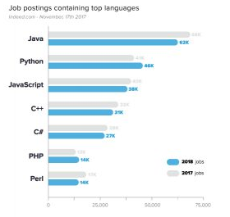
Why would you choose to learn Java?
The reality is that there is a lot of computer languages out there. It's in the hundreds. Why would you choose the Java language?
The number one reason is its popularity. According to many official websites that track popularity of languages, Java is either #1 or in the top 3.
Popularity means more companies and their staff are using it, so there are more career opportunities available for you if you are skilled in the language.
The last thing you want to do is pick a language that is not in mainstream use. Java came out in the 1990's and is still very popular today.

Slide 64
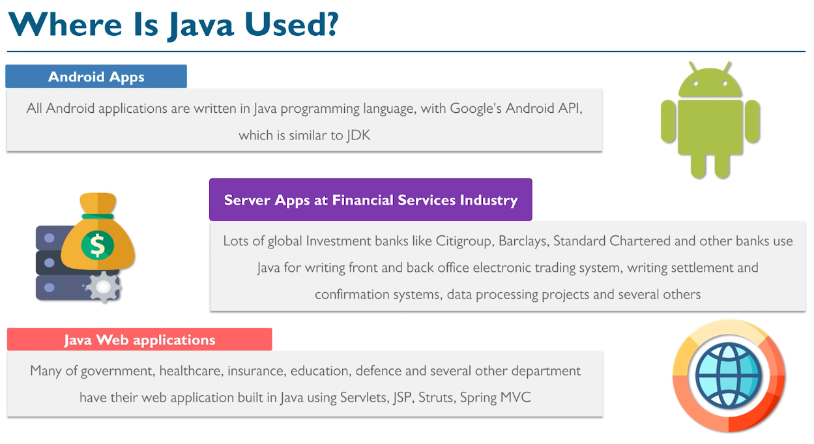

Slide 65
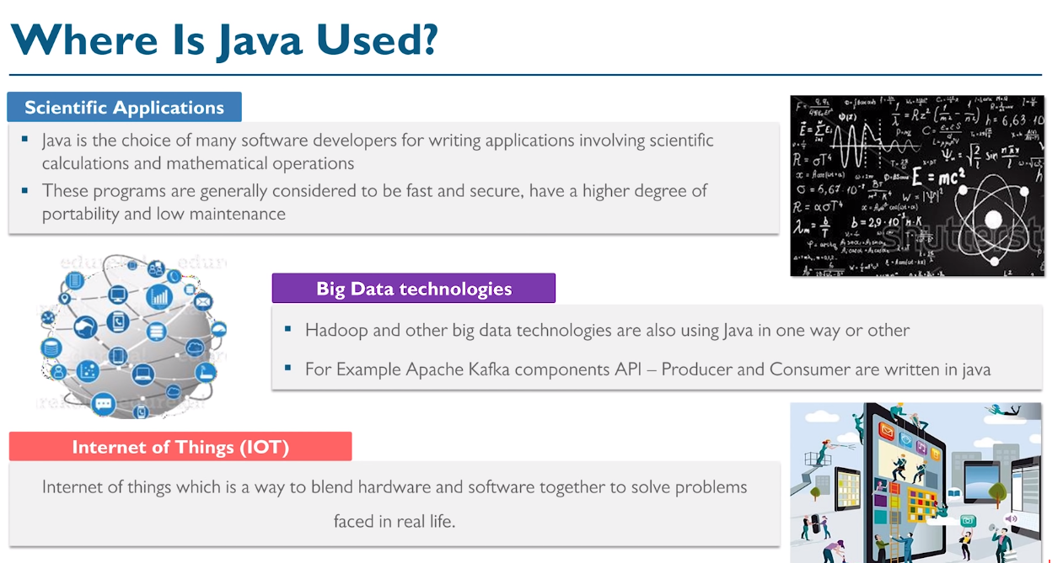

Slide 66

When you start out programming, you don’t know the language that well.
When trying to solve challenges, or write your own programs, you may struggle because you are focused more on the “controls” – e.g. “Which keyword is used to exit a loop again?”.
Or, “Do I put a semi-colon at the end of the line that ends in a left curly brace?”. And so on.
But as you persist, the right keywords come instinctively. You start thinking along the lines of “ok, so I have to exit this loop if the calculation has completed, and then I have to save the results to a file”.
Your brain instinctually tells your fingers to type “break;” to exit that loop, and remembers not to put a semi-colon on a line with a left curly brace, because that's a code block, and you don’t put semi-colons there.
Notes:
THE VEDIO GAME METAPHOR (OR DRIVING A CAR)

Slide 67
I have taught many “first time programmers”.
And the good news is that I have rarely found a student that couldn’t learn to program.
I see it as a basic human skill, just like reading, writing, and arithmetic.
Anyone can do it, it is part of our human capacities, but does need to be learned.

Slide 68
It's about showing persistence to succeed,
When you are starting to learn any skill, you will get frustrated.
You might scream pull your hair ...
You need to persist through that.
Just refuse to give up.
It takes time, dedication and persistence to become a programmer.
If you don’t understand something, research, re-try the exercise.
– Sometimes 2,3 or more times!
If you are frustrated, or worried, or ready to give up, it’s likely you are at the “start of the game” when it comes to programming.

Slide 69
CODING IS LIKE ANY OTHER SKILL...
FOR EXAMPLE SWIMMING, YOU LEARN IT BY DOING, AT FIRST IT'S VERY HARD, YOU'RE SCARED
BUT THEN YOU DO IT WITHOUT THINKING
SO LEARNING TO CODE IN A WEEK IS NOT POSSIBLE
Notes:
تتعلم الجمع و الطرح بعدين الضرب و القسمة ...
بعدين شوي شوي معادلات... المساحة، المحيط ...
بعدين تطبيقات و مواضيع اعقد ...
طيب ليش؟ مهو في الة حاسبة ...
حتى توسع مجال تفكيرك .. و ما تضل محصور بزاوية ذيقة

Slide 70
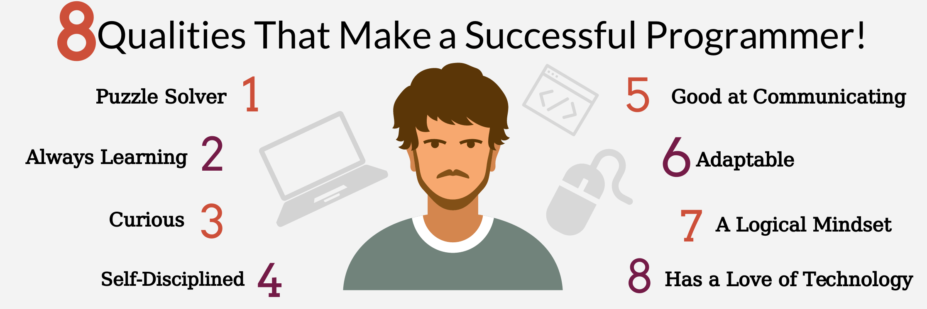

Slide 71
WHAT WILL WE LEARN?
EXAMPLES?

Slide 72
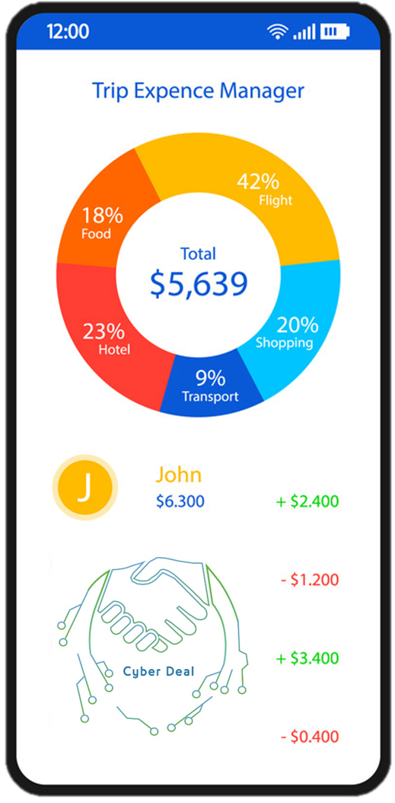
Travel expense tracker
The user will enter the cost for each of the following:
Travel cost,
Food,
Accommodation,
Transportation,
Gifts
Then the program will calculate the total cost for this trip.
Also the program will display the percentage of each category.

Slide 73


CV BUILDER
This system will take little information from the user and will provide him with a fully developed CV in return
Enter your name, contact information, your skills, experience

Slide 74
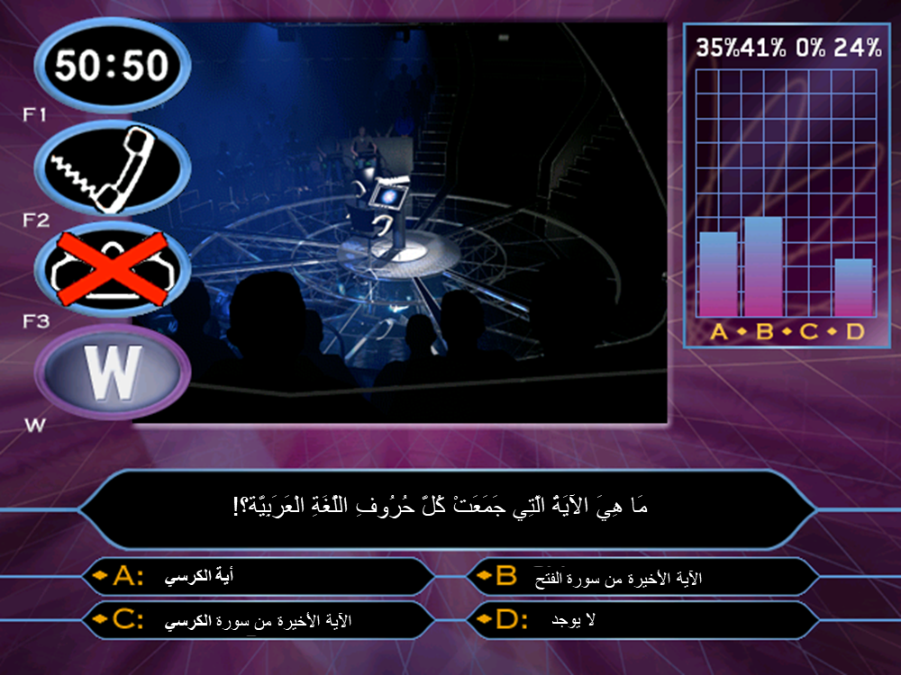
ANSWER PERCENTAGE
Number of people who answered “A”
Number of people who answered “B”
Number of people who answered “C”
Number of people who answered “D”

Slide 75
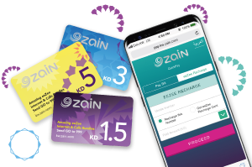

CELLPHONE AIRTIME FEES
Call duration
Provider
Charge per minute (seconds)

Slide 76
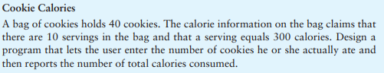

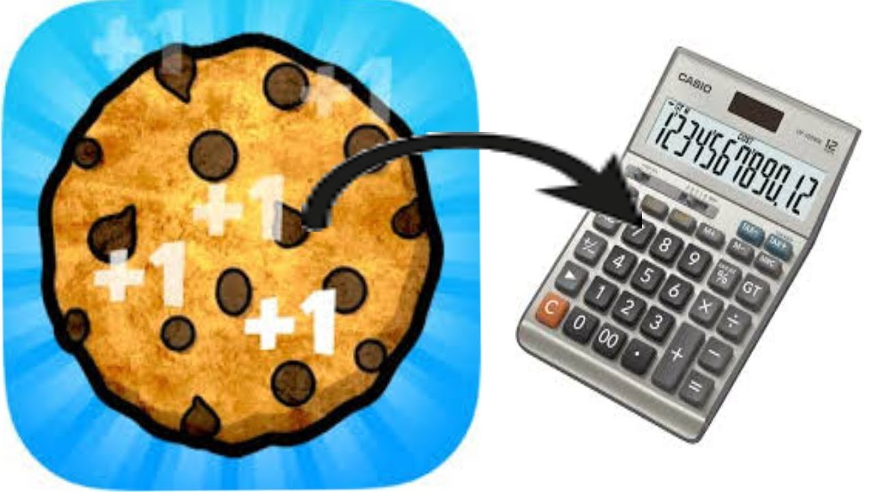

Slide 77
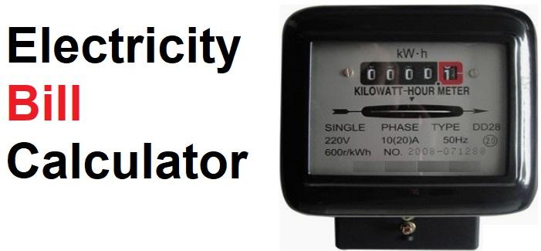
Units used
Price (Per Unit)
Additional Fees
Tax

Slide 78

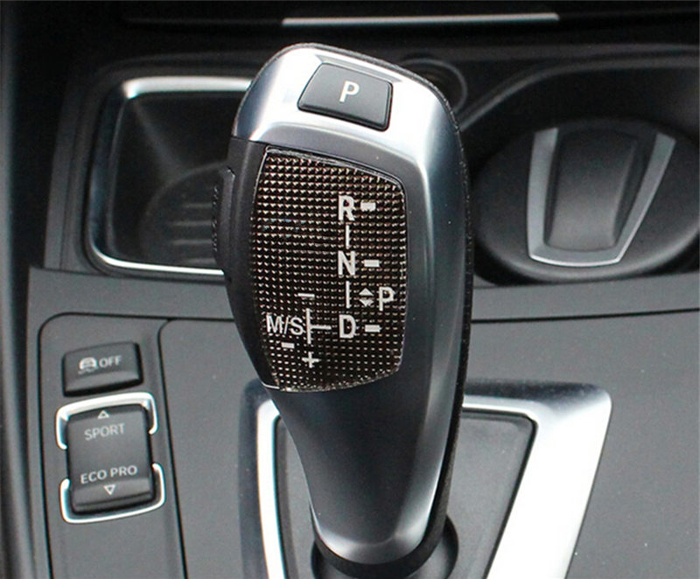
Read Speed From A Sensor or from location data
IF STATE = “D”
If speed is < 20 (Gear 1)
If speed is >= 20 and speed <= 40 (Gear 2)
.
.
.
ELSE IF STATE = “R”
…..
ELSE IF STATE = “P”
“LOCK”
.
.
.
.
.
.

Slide 79
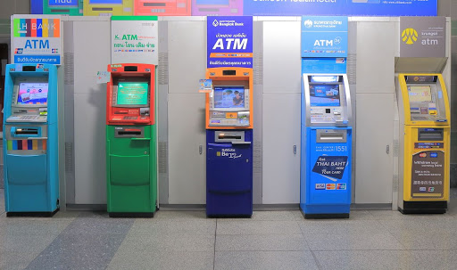
Simple banking program
Basic bank operations:
check balance,
deposit,
withdraw,
transfer,
exit

Slide 80

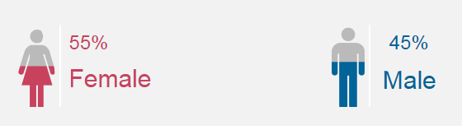

GENDER & AGE PERCENTAGE

Slide 81


GIFT CARDS
Discount Calculator
Card Holder
Random Generated ID

Slide 82
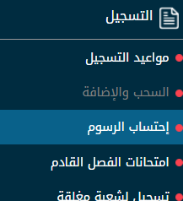

A PROGRAM TO CALCULATE THE SEMESTER FEES

Slide 83
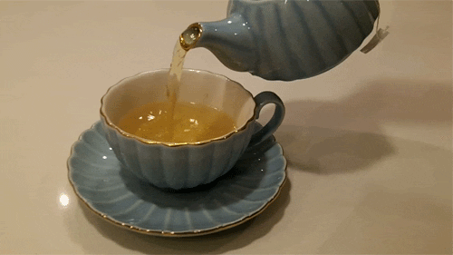

Last month a tea recipe calls for the following ingredients:
* 100 Tea Bags
* 23.5 KG of Sugar
* 60 Leaves of Mint
The recipe produces 48 cups with these amounts of the ingredients.
Design a program that:
* asks the user how many cups he wants to make,
then display
* how much is needed of each ingredient
for the specified number of cups.

Slide 84


Rock Paper Scissors Game

Slide 85



Restaurant System
Display the following statistics for a Restaurant:
○ The total number of served Soft Drinks
○ The total number of served Sandwiches
○ The total sales for the restaurant
○ The average cost per order
○ The maximum and minimum order cost
○ Number of orders with cost above average
○ The number of orders with no Soft Drinks
○ Number of orders
○ Send an auto E-mail on Wednesday

Slide 86
Program to find the mean (average) of 4 numbers
Program to find the area of a rectangle / square / circle
Program to convert from C To F/ km to m / etc…
Program to calculate the age
Program to find the duration of the day
Program to calculate salary based on working hours
Program to reverse your first name

Slide 87
Challenge 1: Remove Even Integers from an Array Challenge 2: Merge Two Sorted Arrays Challenge 3: Find Two Numbers that Add up to "n" Challenge 4: Array of Products of All Elements Except Itself Challenge 5: Find Minimum Value in Array Challenge 6: First Non-Repeating Integer in an Array Challenge 7: Find Second Maximum Value in an Array Challenge 8: Right Rotate the Array by One Index Challenge 9: Re-arrange Positive & Negative Values Challenge 10: Rearrange Sorted Array in Max/Min Form Challenge 11: Find the Sum of Maximum Sum Subarray

Slide 88





INTERVIEW QUESTIONS

Slide 89


UNFORTUNATELY NO GUI

Slide 90


NO GUI
GUI

Slide 91


NO GUI
GUI

Slide 92


NO GUI
GUI

Slide 93


NO GUI
GUI

Slide 94
AND MUCH MORE!!!

